Slide 1

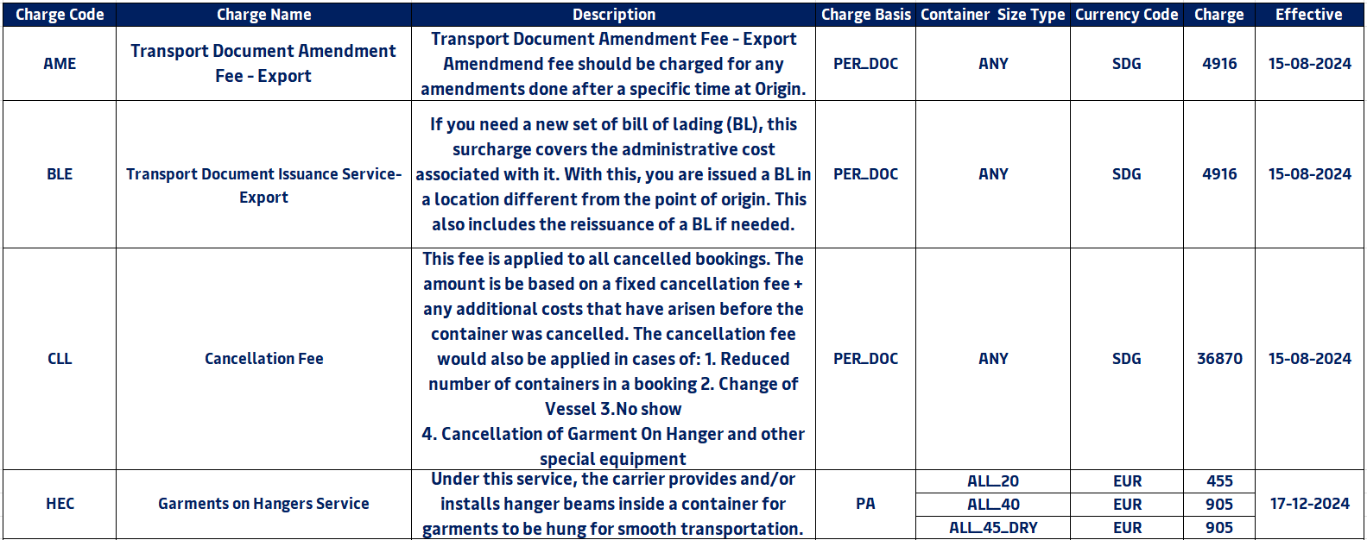
Value Added Services: Sudan to World

Slide 2
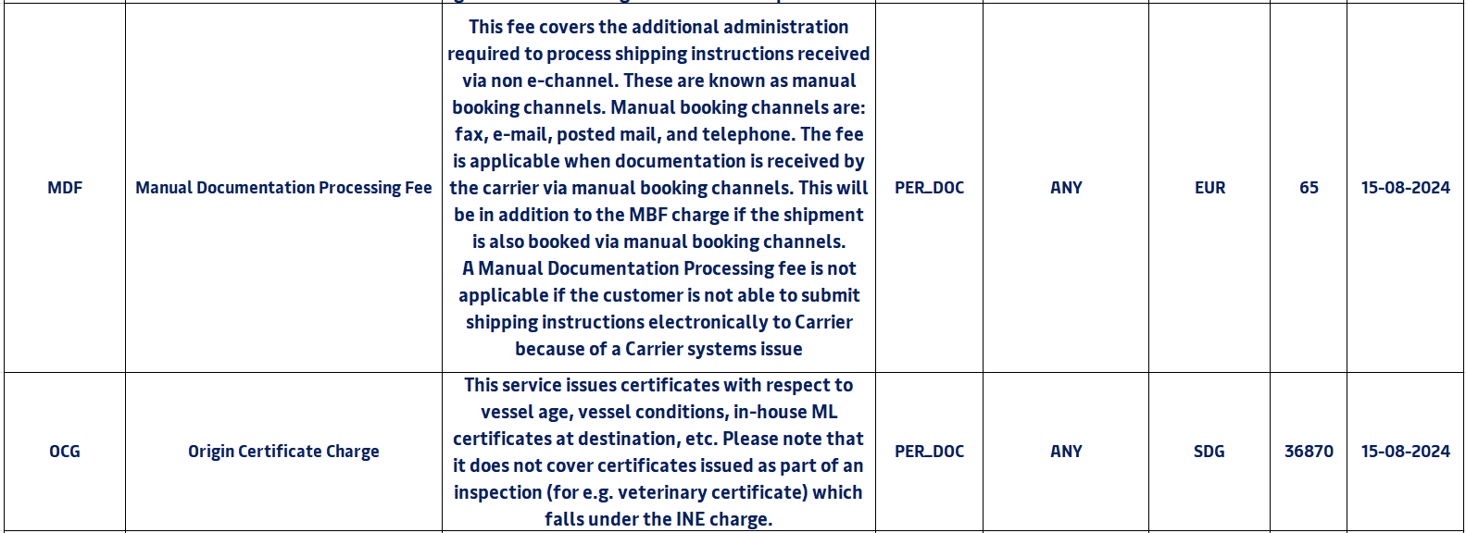
Value Added Services: Sudan to World

Slide 3
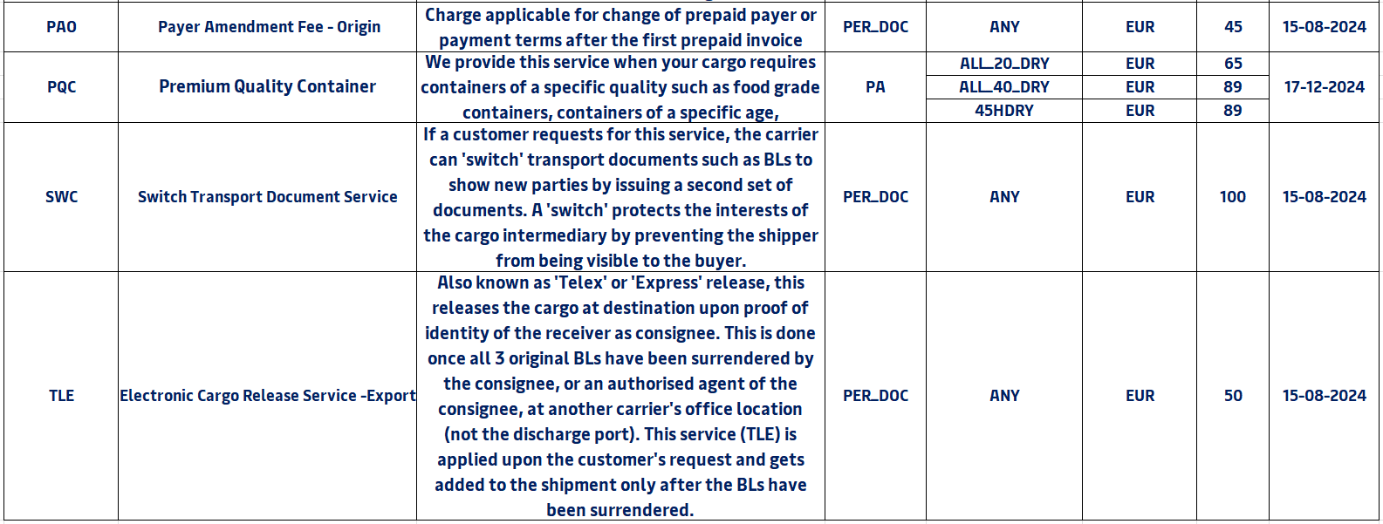
Value Added Services: Sudan to World

Slide 4
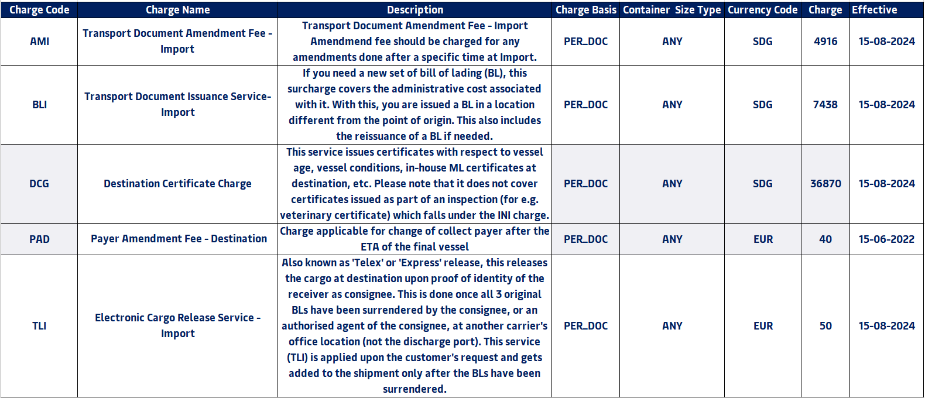
Value Added Services: World to Sudan

