Slide 1
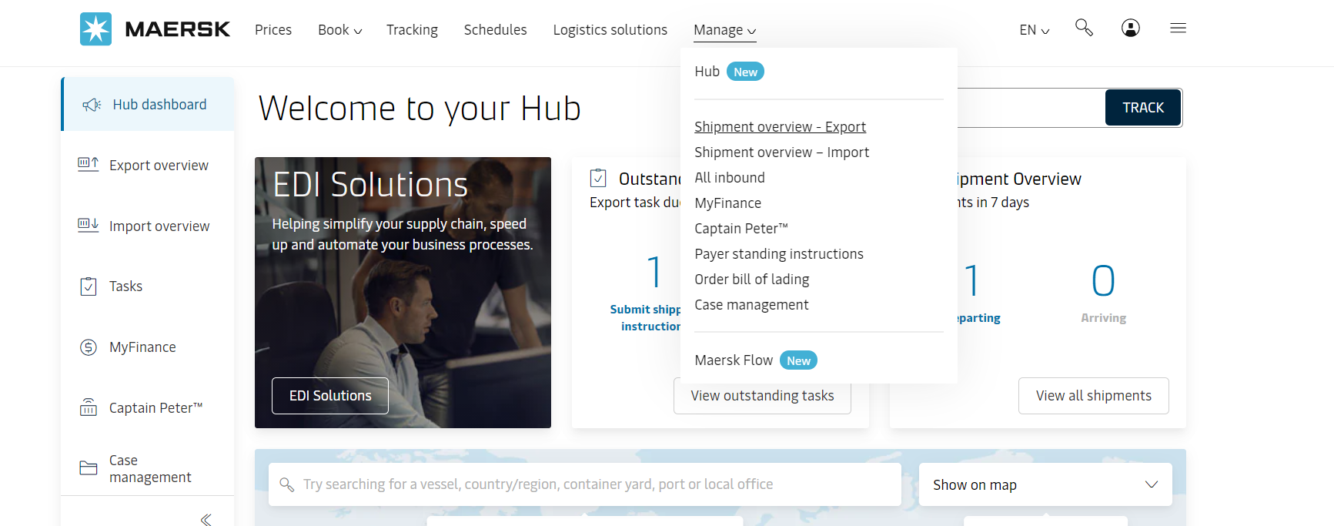
Online Amendment GUIDELINE
Amending a booking is now a lot easier Get booking amendments confirmed in less than
an hour, at just the tap of a button 5 simple steps to get started Log in to maersk.com https://www.maersk.com/portaluser/login

Slide 2
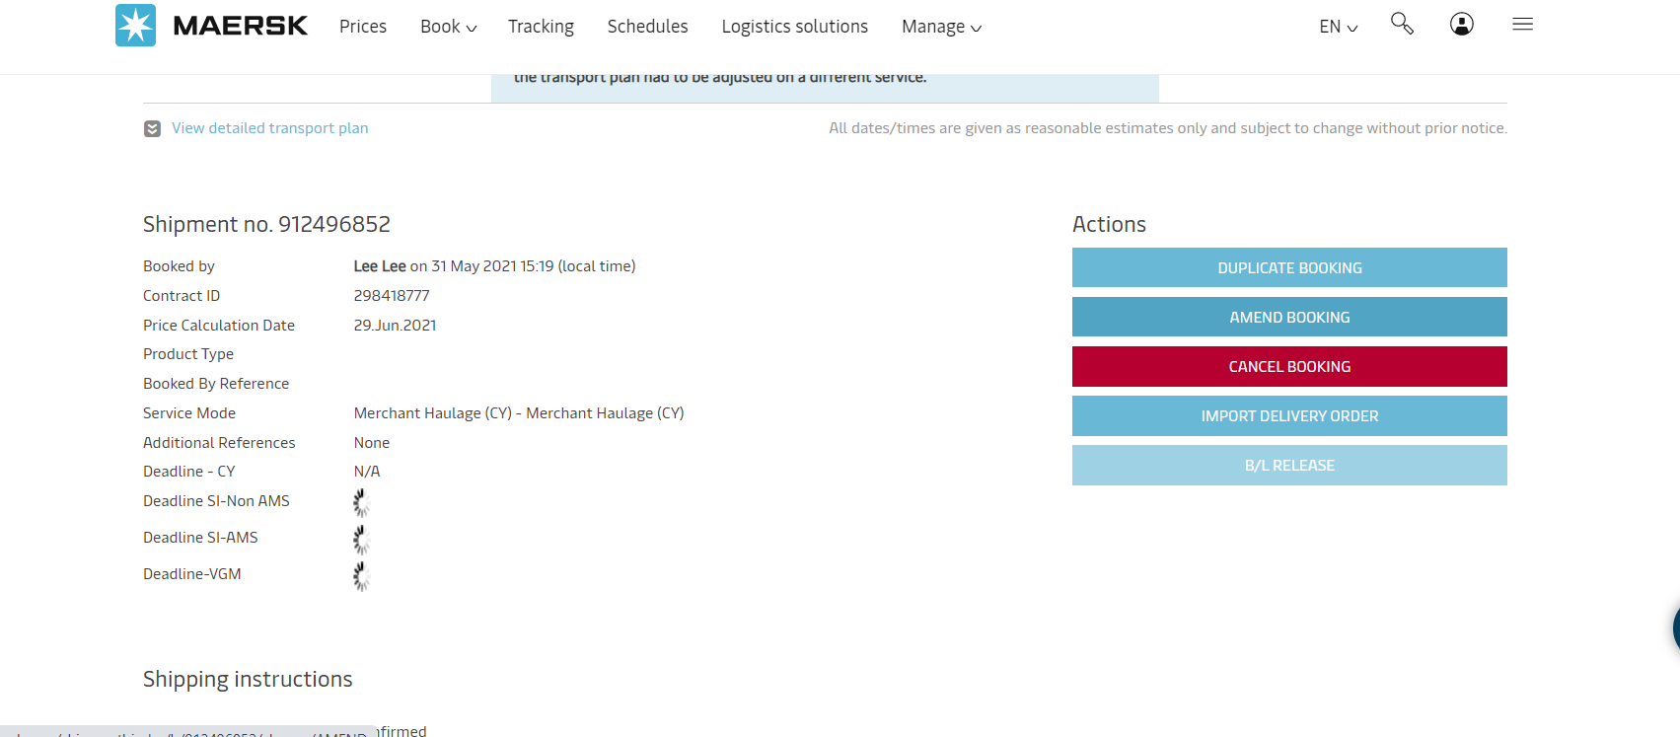

Online Amendment GUIDELINE
Select Shipment Overview - Export from the drop-down menu.
Next to your booking, click on Booking Number.
Now click on Amend Booking.

Slide 3
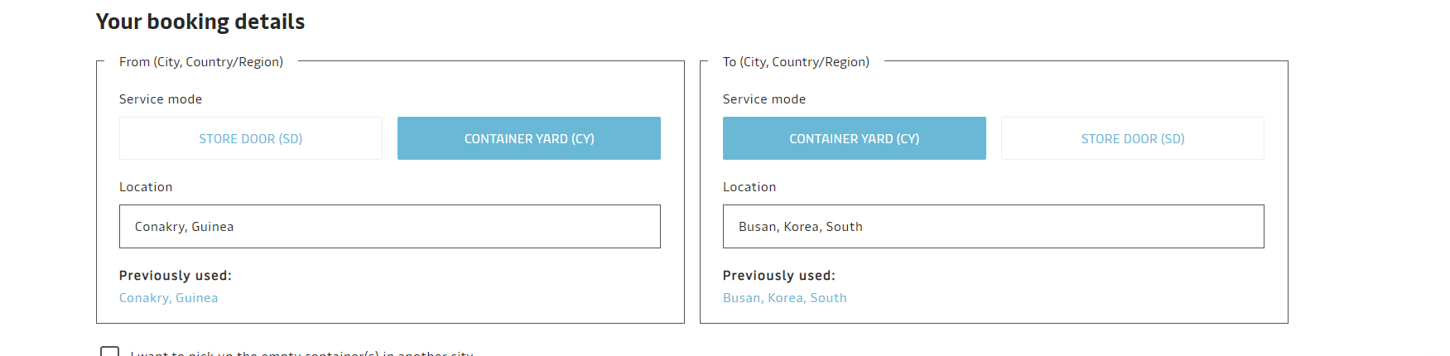
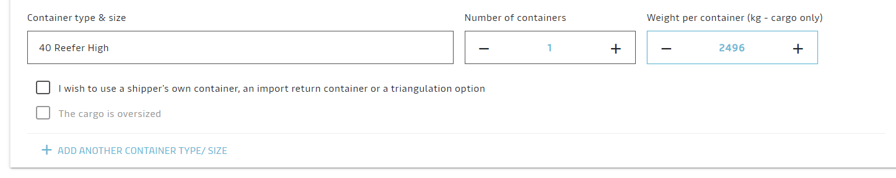
Online Amendment GUIDELINE
You can now request for the following BL amendments
Here is what you can amend :
Origin Destination port
Container type & size
Container Quantity

Slide 4
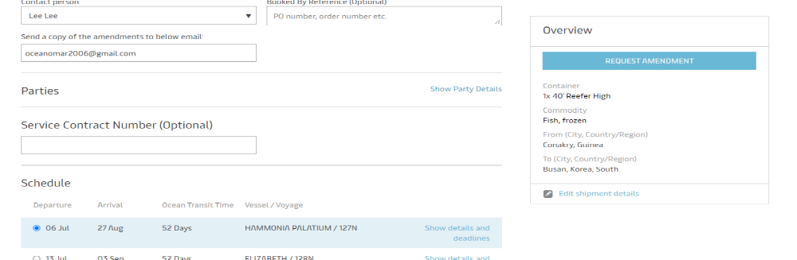
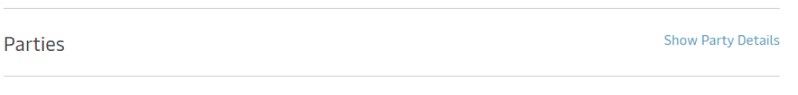
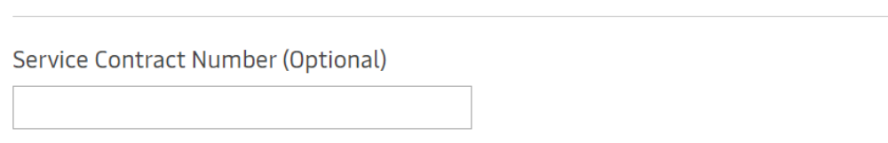
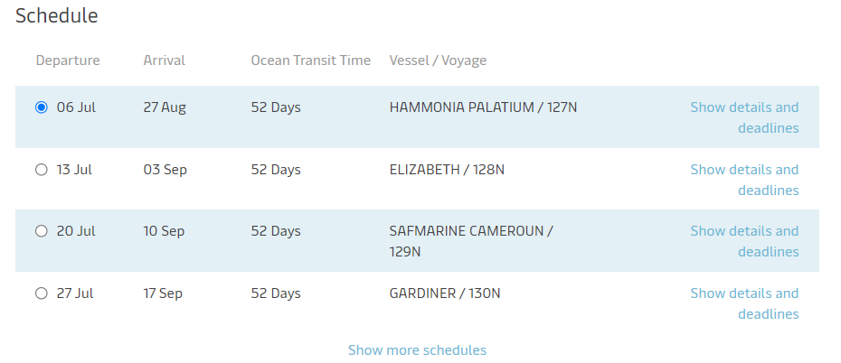
Online Amendment GUIDELINE
Click continue where we have multiple
choice
Here is what you can amend :
Change parties
Service contract
change Schedule

Slide 5
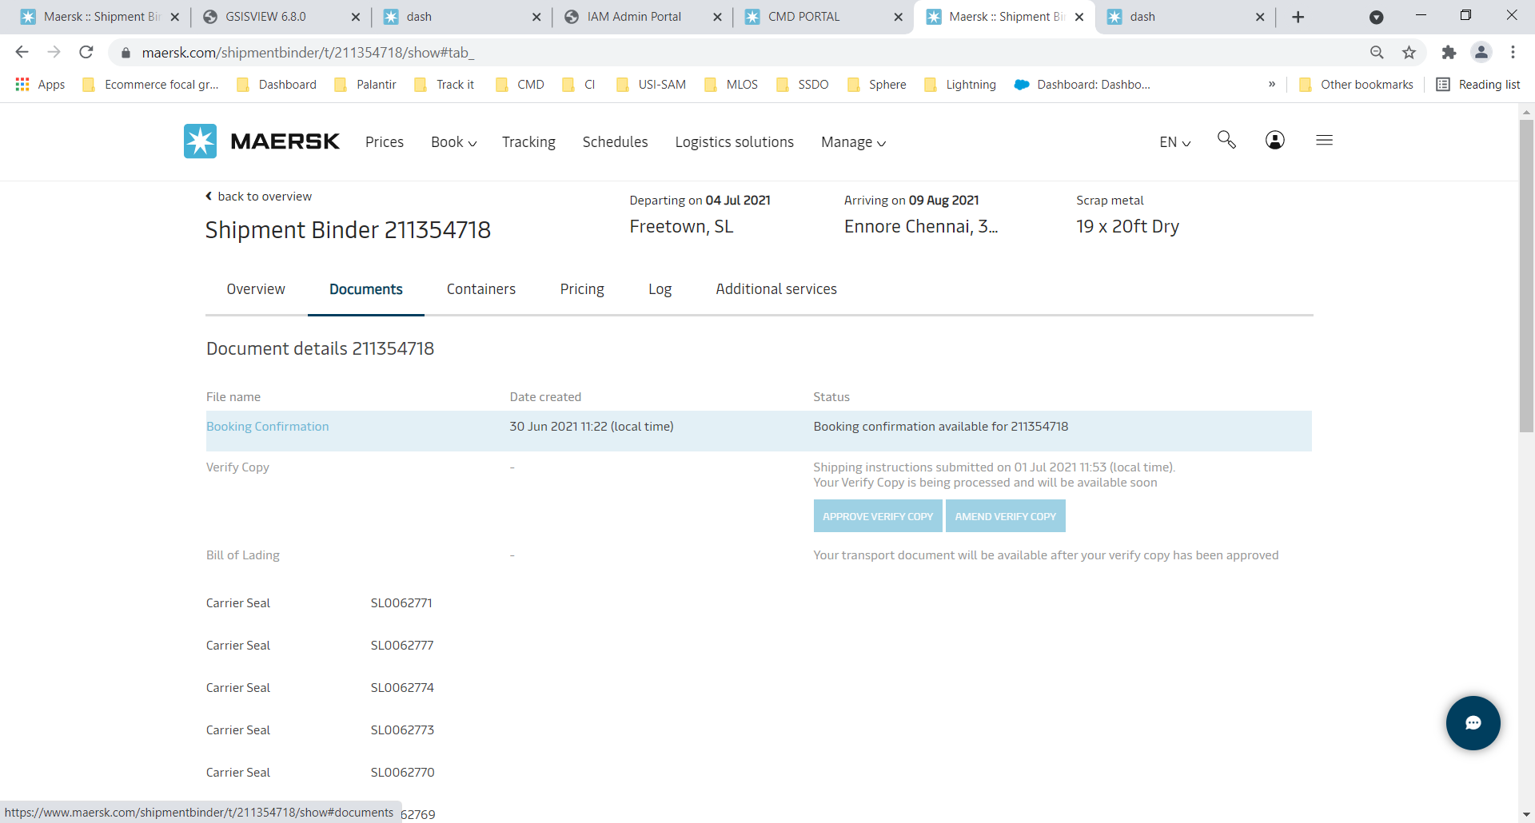
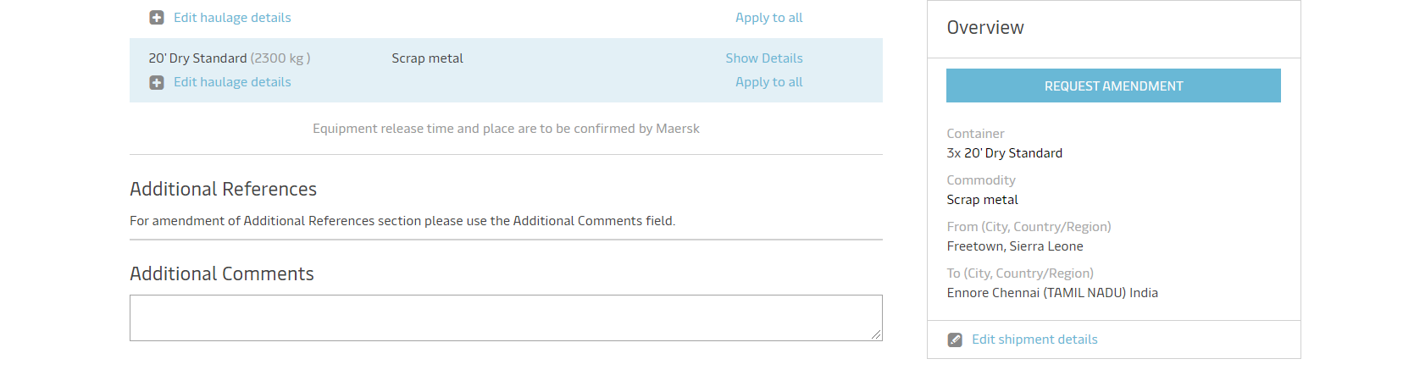
Online Amendment GUIDELINE
If you require other type of amendment you can update it in the additional comments box then click on request amendment We will then process your request and share a booking copy on email or the website in the document section.
So log on to maersk.com and amend your bookings in just a few clicks.

